Slide 1
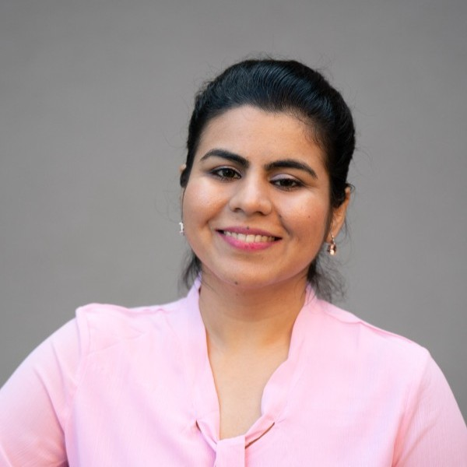
Abha Yadav
Marketing Portfolio

Slide 2
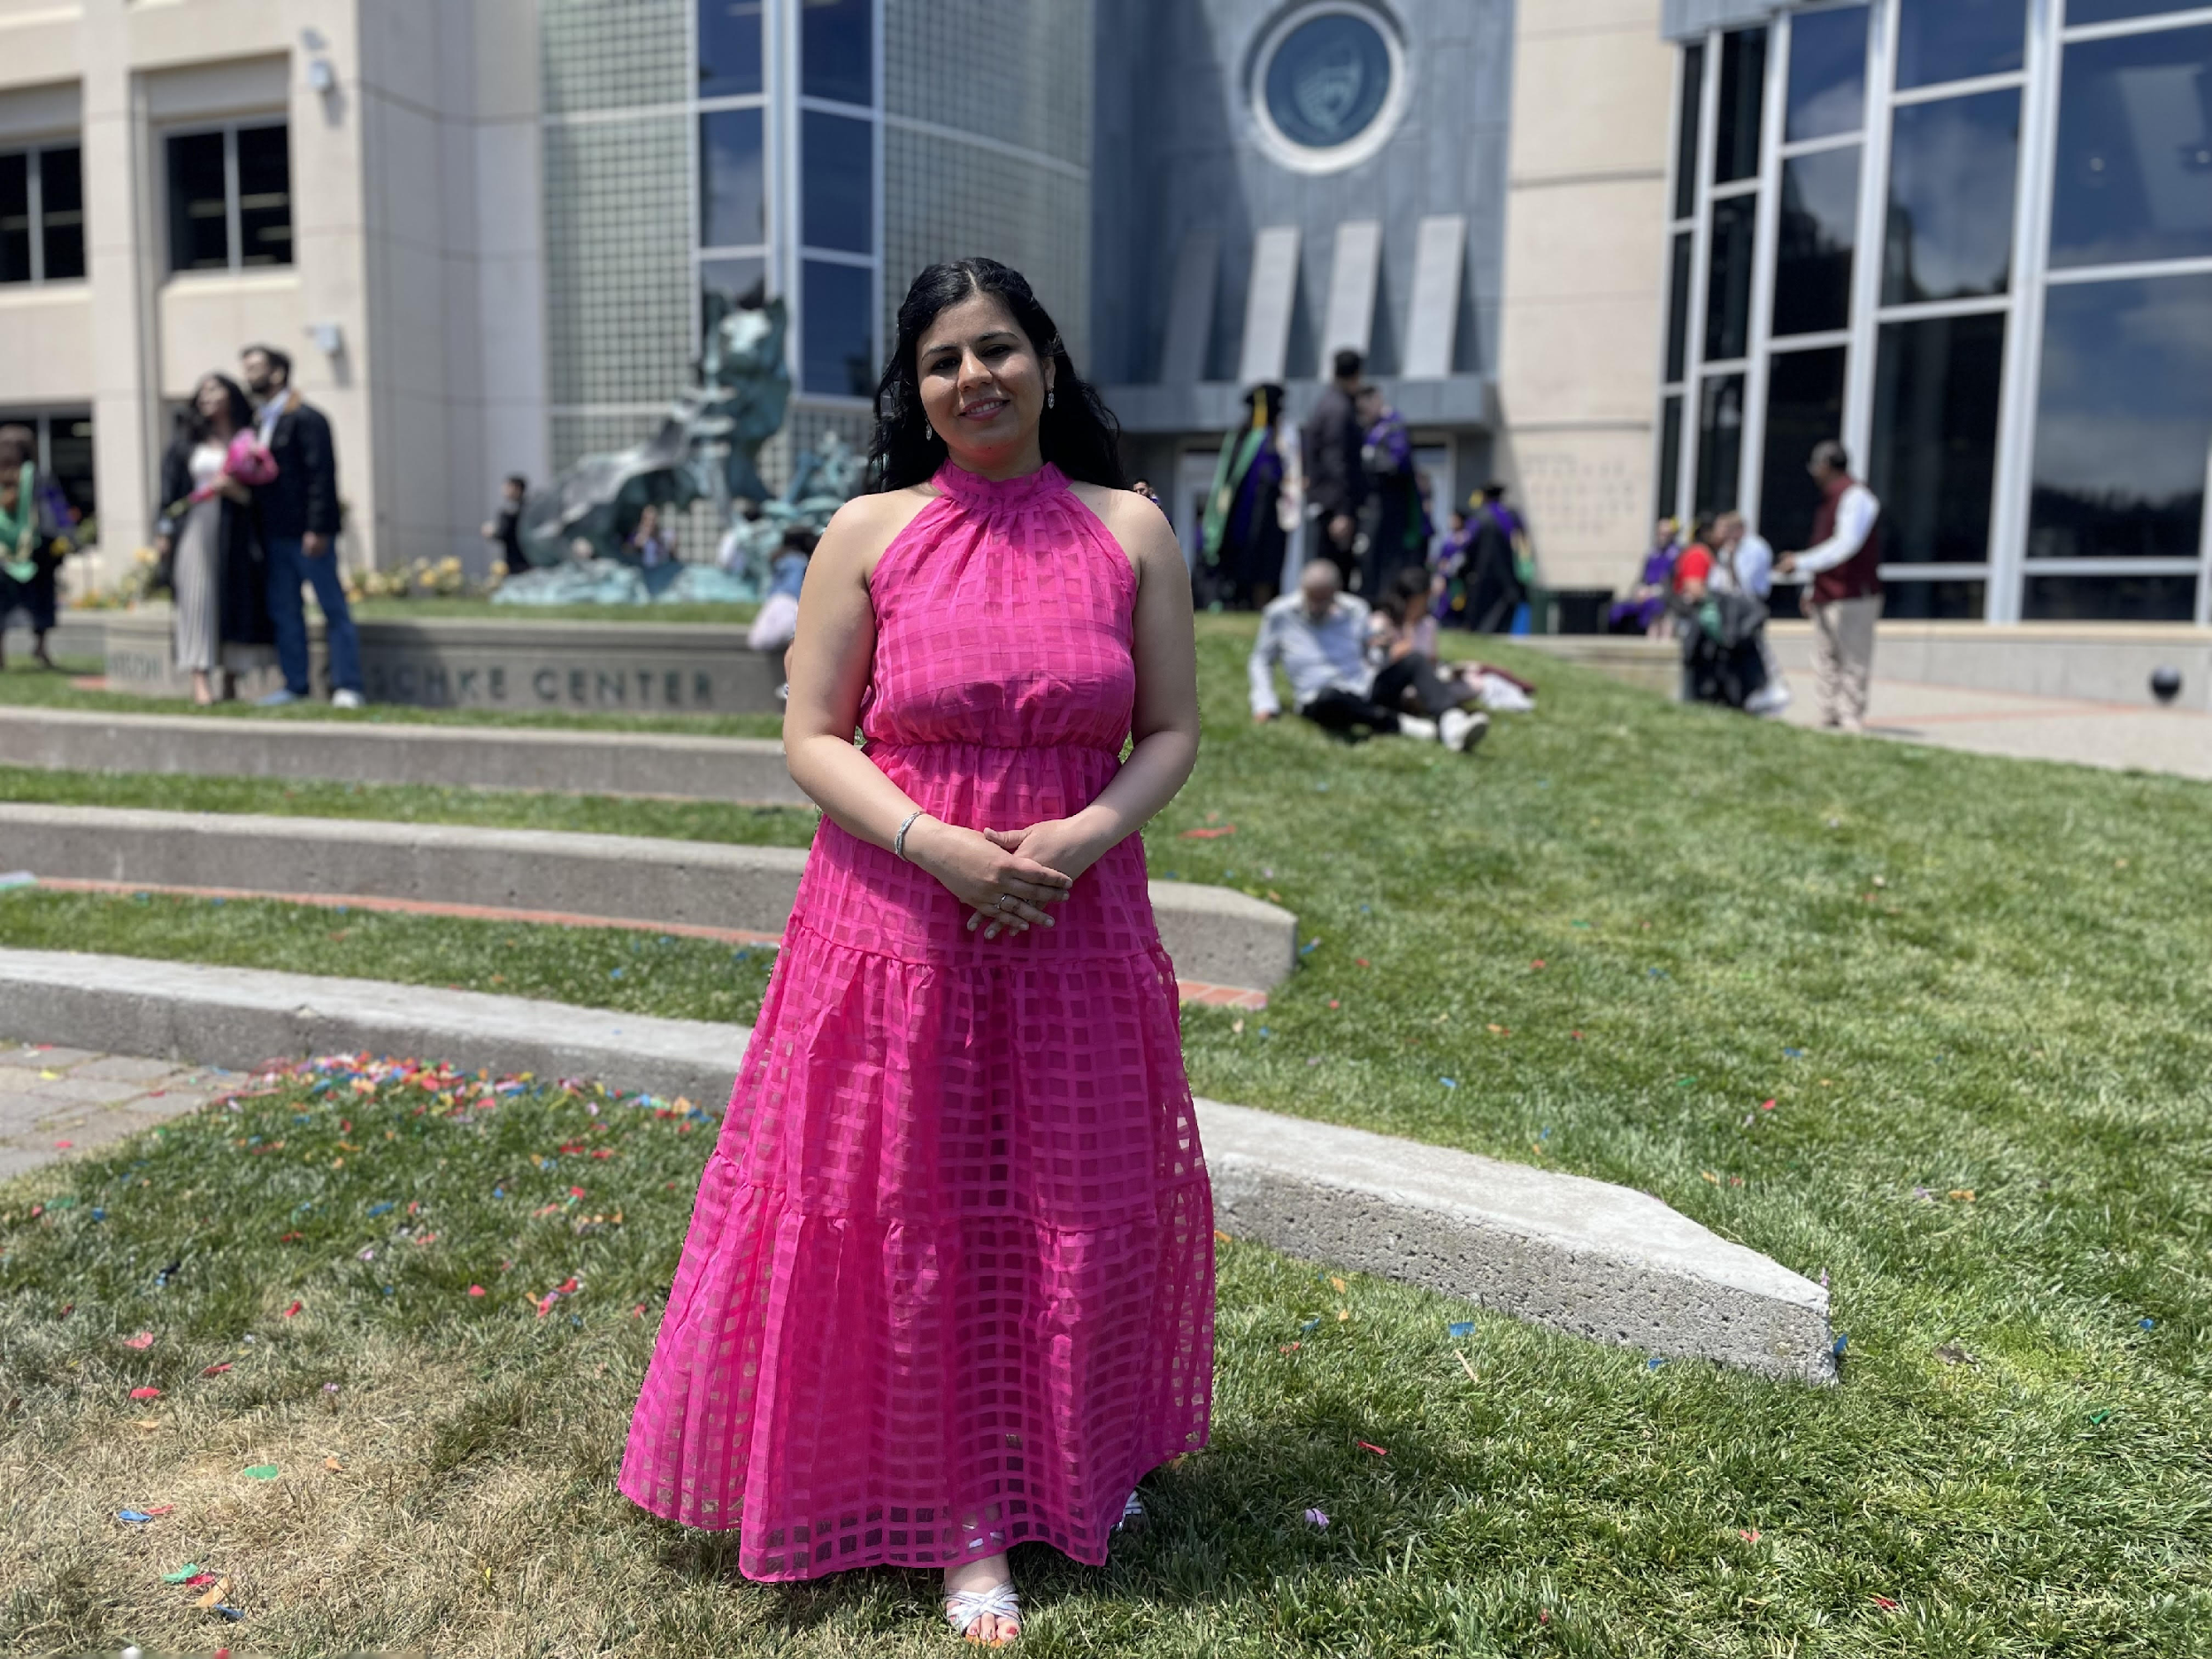
ABOUT ME
ABOUT ME
I started my professional journey as a dentist but soon found myself in the eclectic world of marketing thanks to my love of stories and media.
Taking a deep dive into the minds of the consumers and creating content that most resonates with them is something I am most passionate about.
It is my mission in life to create campaigns that stay in the minds of the people and ensure their continued love and support for the brand for generations…

Slide 3



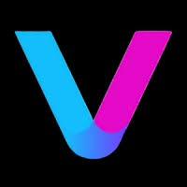
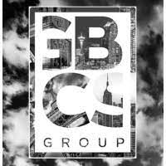
WORK EXPERIENCE
TATA 1MG HEALTHCARE
CREDIHEALTH
WEEE! INC.
VOSYN, AI VENTURE LABS
SKYIT SERVICES, GBCS GROUP
Brand Marketing
Digital Marketing
Growth Marketing
Market Planning
B2B Marketing,Social

Slide 4
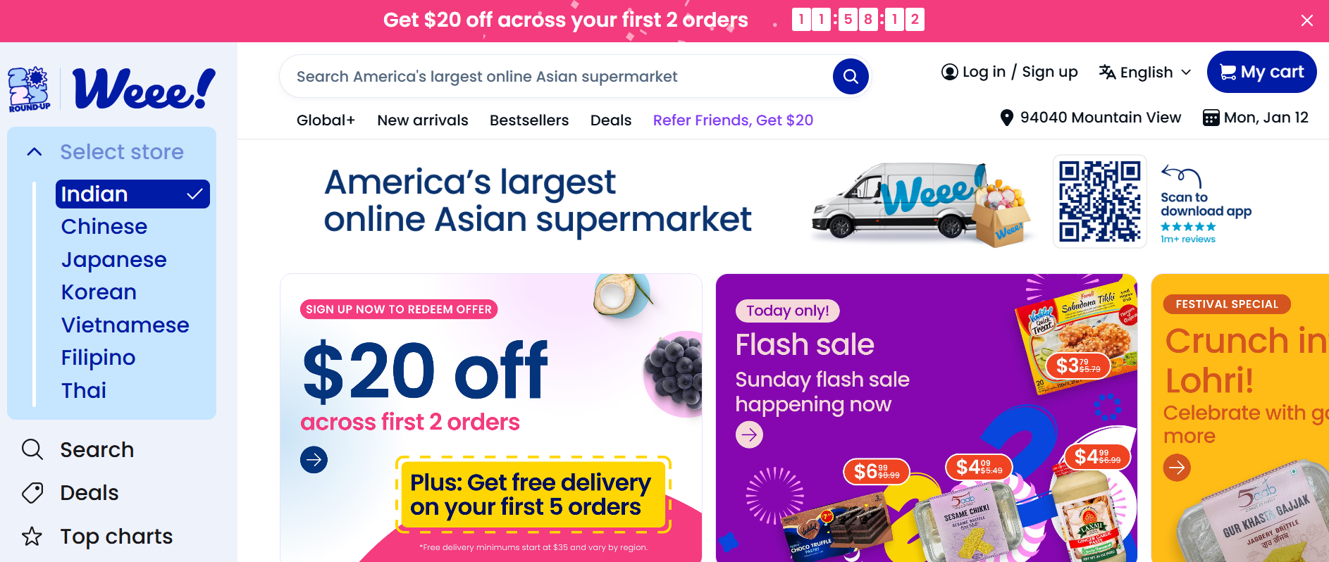
Weee! Inc. ( Online grocery platform )
ORGANIZATION

Slide 5
PERFORMANCE MARKETING
PROJECT
GOAL: To boost brand market share by expanding brand reach, recognition and sales through paid media marketing campaign across TV, Streaming platforms and YouTube
ACTION: Created paid media marketing plan including budget and forecasted results for management approval, formulated different video advertisements emphasizing brand attributes like trust, affordability and convenience, signed on a movie celebrity and partnered and negotiated with 3rd party agencies and sponsors for creation and distribution of ads across multiple media channels, followed by real-time analysis and optimization.
RESULT: The web traffic increased 300% within 10 days of campaign launch, the daily sales increased by 150%, 2 million new users acquired through the campaign, budget estimated at 25 million rupees and ROI at 180%.

Slide 6
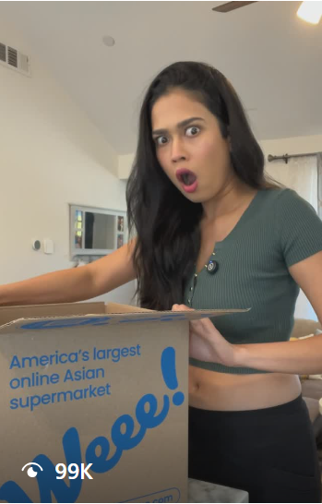
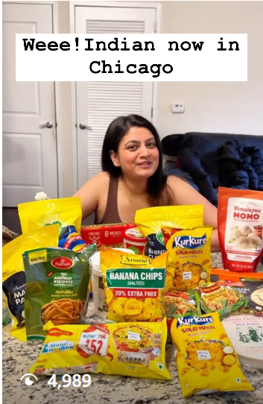
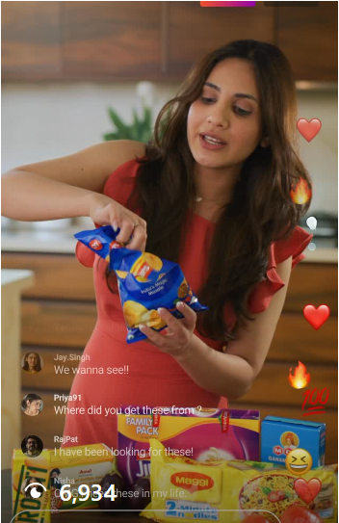
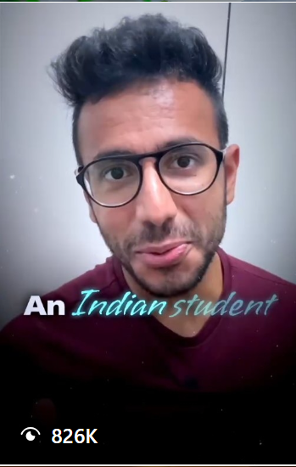
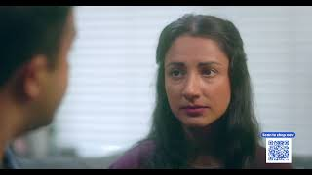
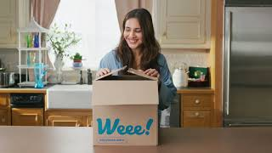
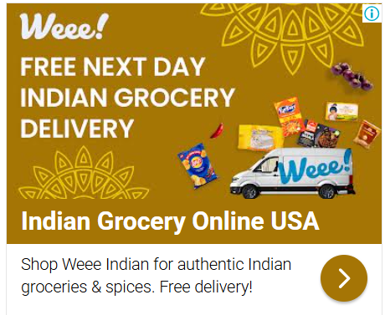
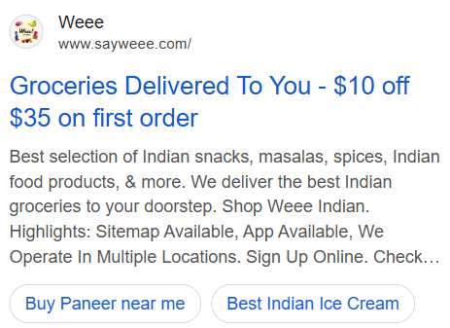
SAMPLES
Content highlights: Instagram, Facebook, YouTube and Google campaigns
Emphasizing Brand Trust
Genuine Medicines Campaign

Slide 7
AI VIDEO GENERATION
PROJECT
GOAL: To boost brand market share by expanding brand reach, recognition and sales through paid media marketing campaign across TV, Streaming platforms and YouTube
ACTION: Created paid media marketing plan including budget and forecasted results for management approval, formulated different video advertisements emphasizing brand attributes like trust, affordability and convenience, signed on a movie celebrity and partnered and negotiated with 3rd party agencies and sponsors for creation and distribution of ads across multiple media channels, followed by real-time analysis and optimization.
RESULT: The web traffic increased 300% within 10 days of campaign launch, the daily sales increased by 150%, 2 million new users acquired through the campaign, budget estimated at 25 million rupees and ROI at 180%.

Slide 8
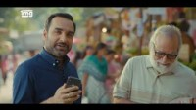
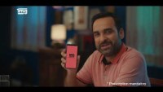
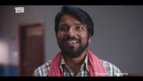
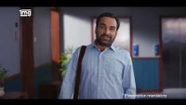
SAMPLES
KEY ADVERTISING CAMPAIGNS across TV,YouTube and Streaming platforms
Emphasizing Brand Trust
Subscription Plan Promotion
Genuine Medicines Campaign
Fast Delivery Campaign

Slide 9
INFLUENCER AND SOCIAL MEDIA MARKETING
PROJECT
GOAL: To boost brand market share by expanding brand reach, recognition and sales through paid media marketing campaign across TV, Streaming platforms and YouTube
ACTION: Created paid media marketing plan including budget and forecasted results for management approval, formulated different video advertisements emphasizing brand attributes like trust, affordability and convenience, signed on a movie celebrity and partnered and negotiated with 3rd party agencies and sponsors for creation and distribution of ads across multiple media channels, followed by real-time analysis and optimization.
RESULT: The web traffic increased 300% within 10 days of campaign launch, the daily sales increased by 150%, 2 million new users acquired through the campaign, budget estimated at 25 million rupees and ROI at 180%.

Slide 10
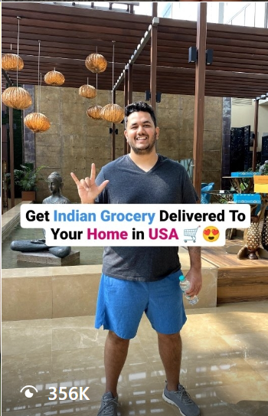
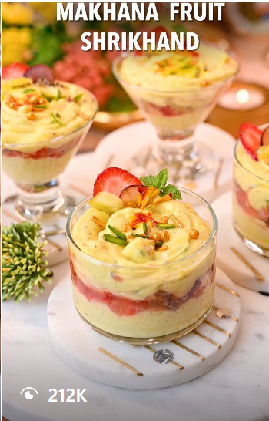
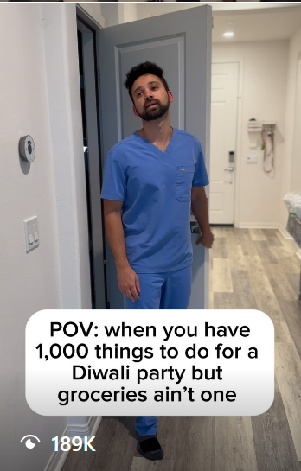
SAMPLES
KEY ADVERTISING CAMPAIGNS across TV,YouTube and Streaming platforms
Emphasizing Brand Trust
Subscription Plan Promotion

Slide 11
EVENT MARKETING
PROJECT
GOAL: To boost brand market share by expanding brand reach, recognition and sales through paid media marketing campaign across TV, Streaming platforms and YouTube
ACTION: Created paid media marketing plan including budget and forecasted results for management approval, formulated different video advertisements emphasizing brand attributes like trust, affordability and convenience, signed on a movie celebrity and partnered and negotiated with 3rd party agencies and sponsors for creation and distribution of ads across multiple media channels, followed by real-time analysis and optimization.
RESULT: The web traffic increased 300% within 10 days of campaign launch, the daily sales increased by 150%, 2 million new users acquired through the campaign, budget estimated at 25 million rupees and ROI at 180%.

Slide 12
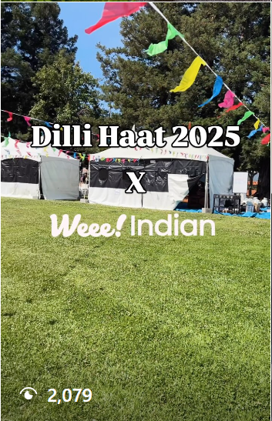
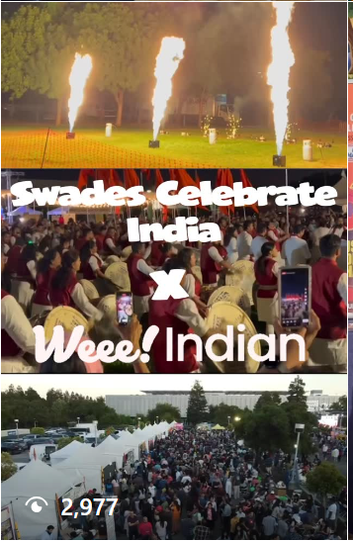
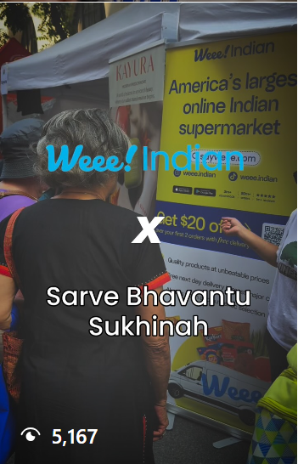
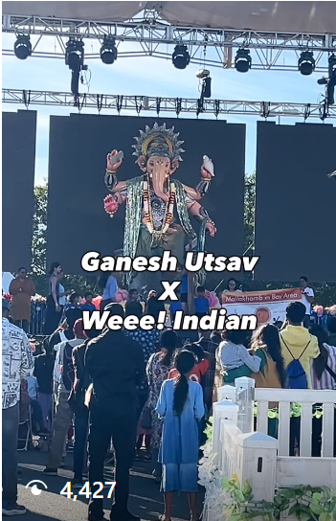

SAMPLES
KEY ADVERTISING CAMPAIGNS across TV,YouTube and Streaming platforms
Emphasizing Brand Trust
Subscription Plan Promotion

Slide 13
3rd PARTY PARTNERSHIPS AND PROMOTIONS
PROJECT
GOAL: To boost brand market share by expanding brand reach, recognition and sales through paid media marketing campaign across TV, Streaming platforms and YouTube
ACTION: Created paid media marketing plan including budget and forecasted results for management approval, formulated different video advertisements emphasizing brand attributes like trust, affordability and convenience, signed on a movie celebrity and partnered and negotiated with 3rd party agencies and sponsors for creation and distribution of ads across multiple media channels, followed by real-time analysis and optimization.
RESULT: The web traffic increased 300% within 10 days of campaign launch, the daily sales increased by 150%, 2 million new users acquired through the campaign, budget estimated at 25 million rupees and ROI at 180%.

Slide 14
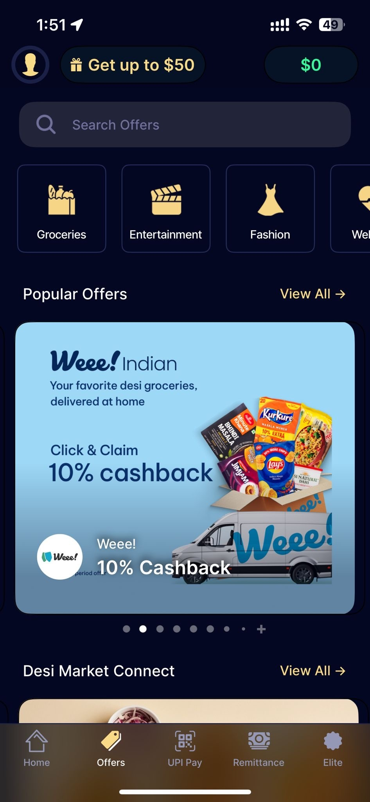
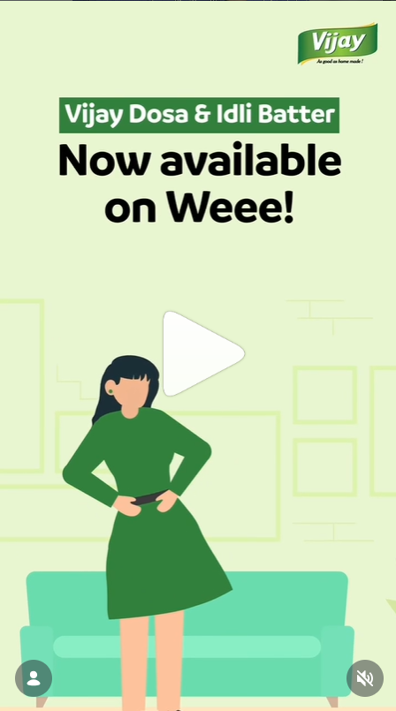
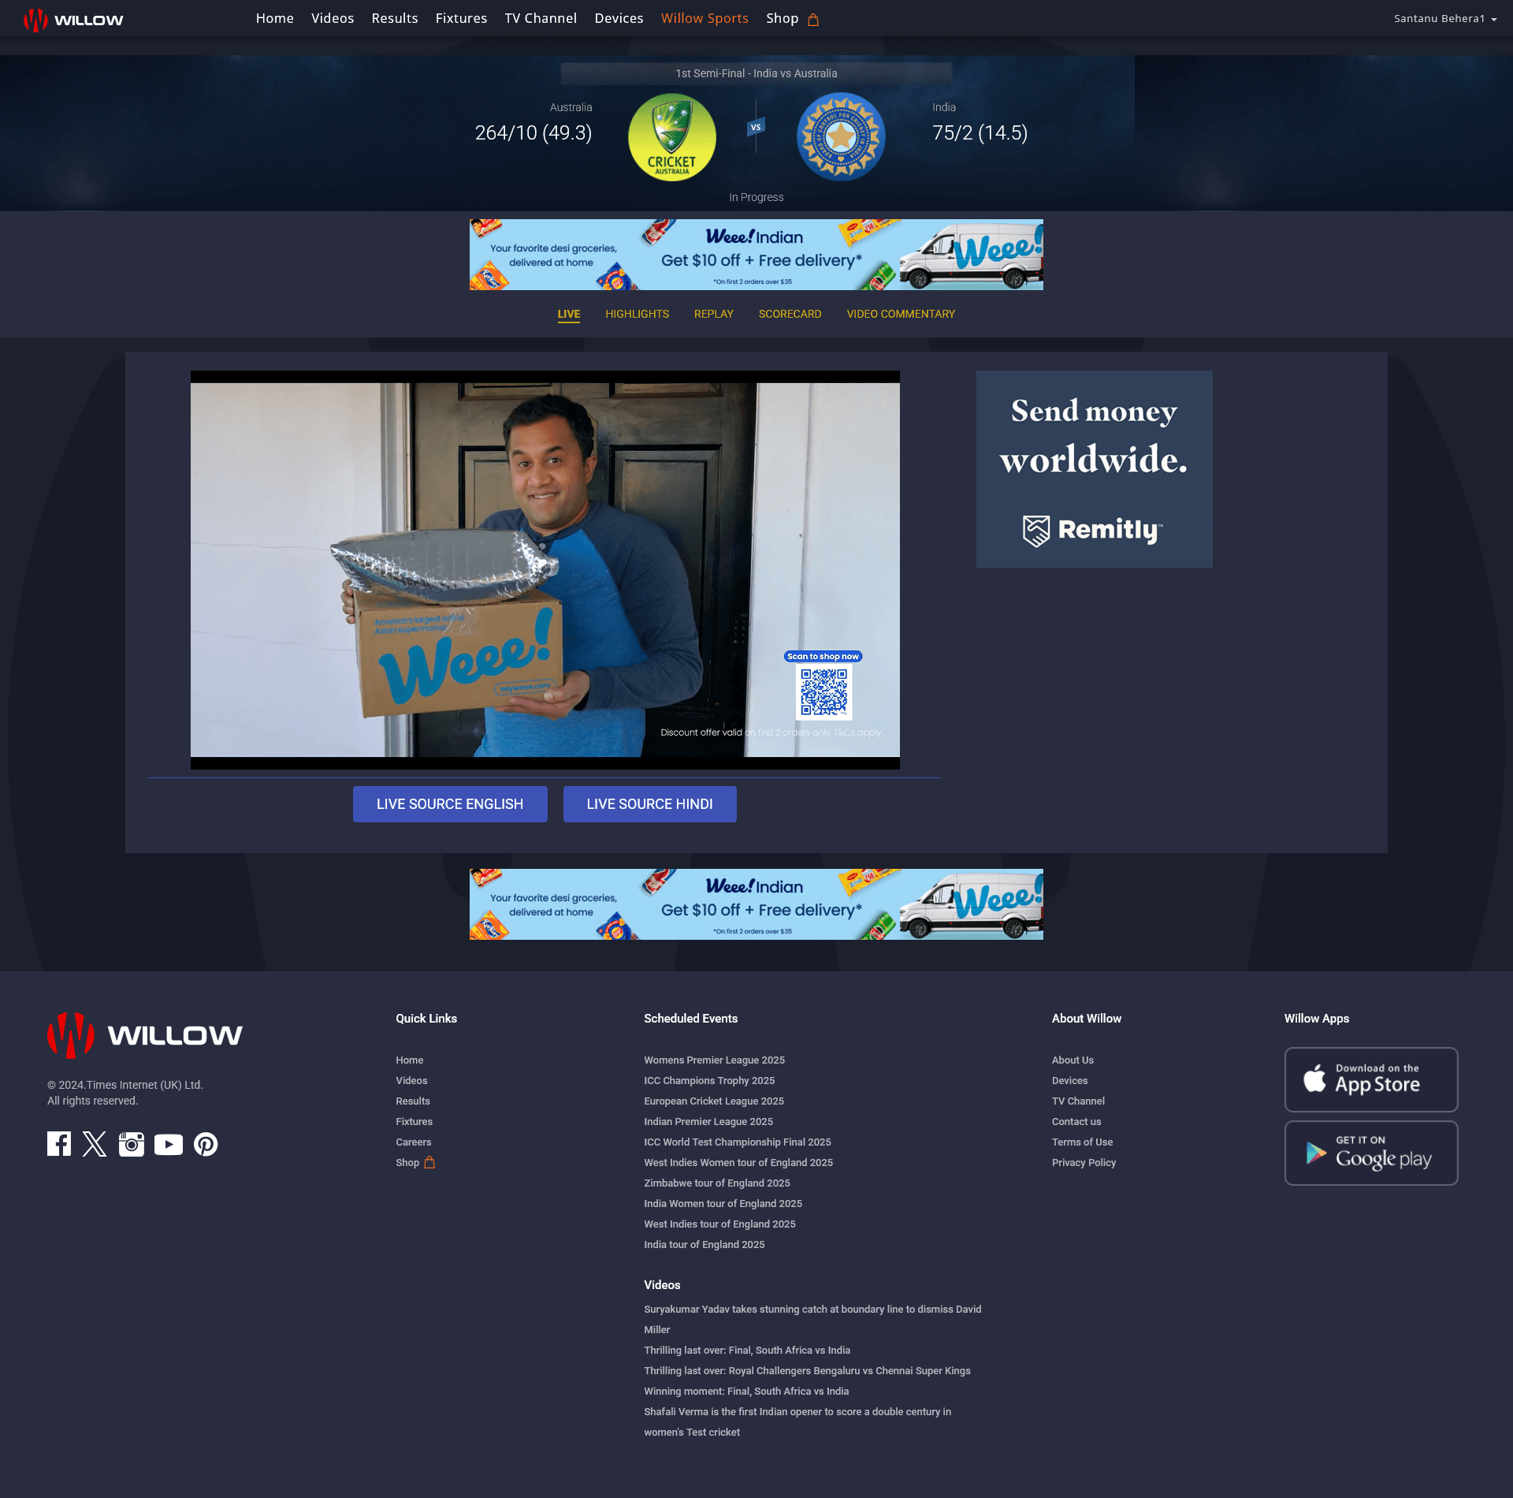
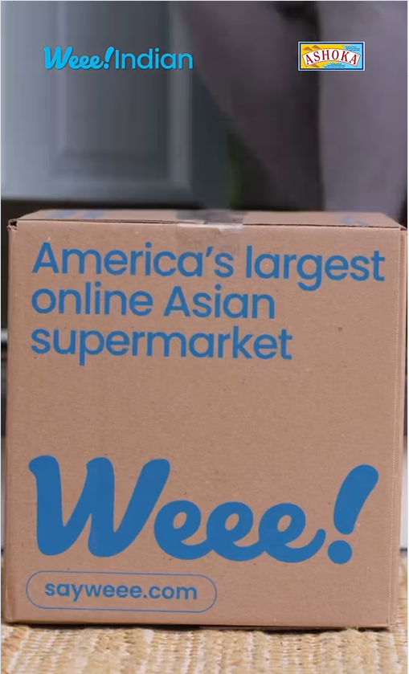
SAMPLES
KEY ADVERTISING CAMPAIGNS across TV,YouTube and Streaming platforms
Emphasizing Brand Trust
Subscription Plan Promotion

Slide 15
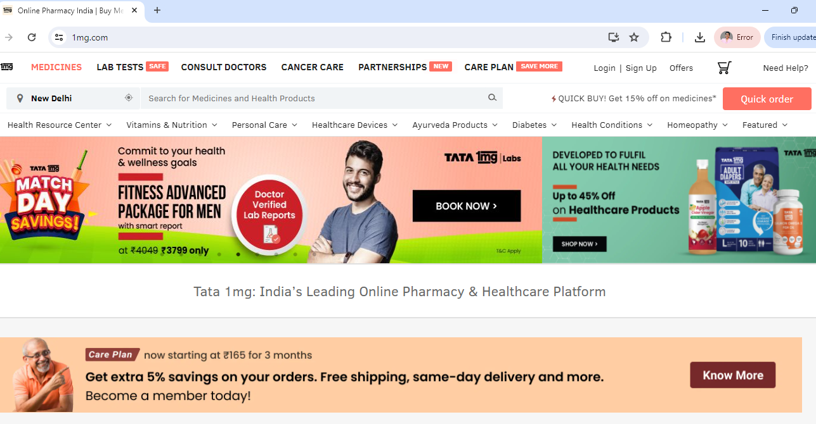
TATA 1MG Healthcare( Healthcare eCommerce platform )
ORGANIZATION

Slide 16
TV and DIGITAL ADVERTISING
PROJECT
GOAL: To boost brand market share by expanding brand reach, recognition and sales through paid media marketing campaign across TV, Streaming platforms and YouTube
ACTION: Created paid media marketing plan including budget and forecasted results for management approval, formulated different video advertisements emphasizing brand attributes like trust, affordability and convenience, signed on a movie celebrity and partnered and negotiated with 3rd party agencies and sponsors for creation and distribution of ads across multiple media channels, followed by real-time analysis and optimization.
RESULT: The web traffic increased 300% within 10 days of campaign launch, the daily sales increased by 150%, 2 million new users acquired through the campaign, budget estimated at 25 million rupees and ROI at 180%.

Slide 17
SAMPLES
KEY ADVERTISING CAMPAIGNS across TV,YouTube and Streaming platforms
Emphasizing Brand Trust
Subscription Plan Promotion
Genuine Medicines Campaign
Fast Delivery Campaign

Slide 18
Social Media Marketing
PROJECT
GOAL: To enhance brand recognition among the younger demographic through increased visibility on meaningful engagement on social media.
ACTION: Created social media marketing calendar for brand posts on Instagram, Tik Tok and YouTube centered around authentic health advice and medical information, topical events like Mother’s day, World AIDS day and special brand campaigns and initiatives.
RESULT: Majority social media posts gathered > 50,000 views, the subscribers increased by 90% over the course of 3 months and website traffic and sales attributed to social media redirections rose up by 60%

Slide 19
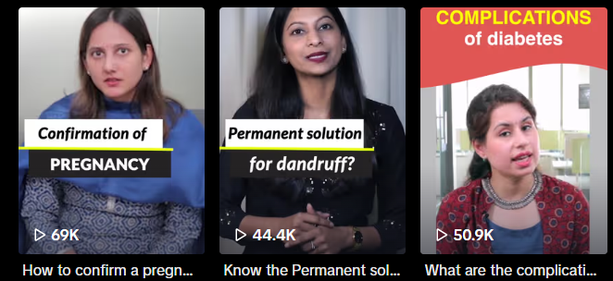
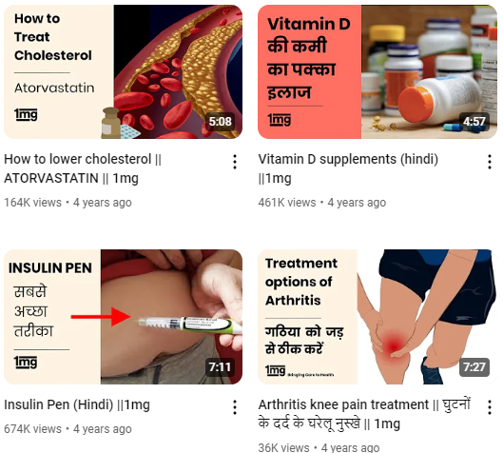
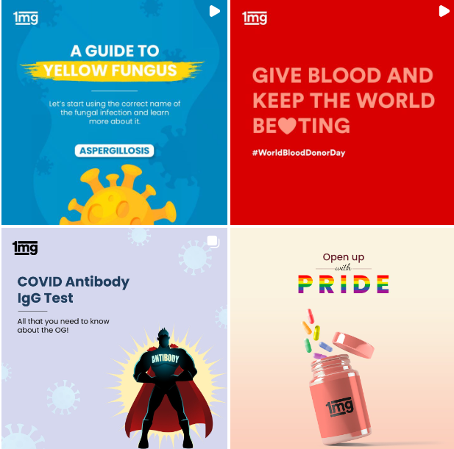
SAMPLES
TikTok Videos
YouTube Videos
Instagram
Posts

Slide 20
Partner Marketing ( B2B, B2B2C)
PROJECT
GOAL:To boost digital platform growth by promoting the e-commerce services and offerings through online and offline partners, by building and maintaining affiliate network and initiating and managing strategic partnerships with trusted organizations.
ACTION: Used Newspaper Advertisements, Website and Google ads to generate inbound affiliate and partnership leads , onboarded reputed strategic partners through LinkedIn messages and Emails, followed by calls/meetings, pitch presentations, contract signing and in certain cases, API integrations.
RESULT: Onboarded 30+ affiliates/partners each month, bringing in revenue of
> 1 million rupees monthly from partner accounts through B2B2C brand content and offer promotion across partner channels such as website and app landing pages, rewards program, physical brochures , promotional emails and messages.

Slide 21
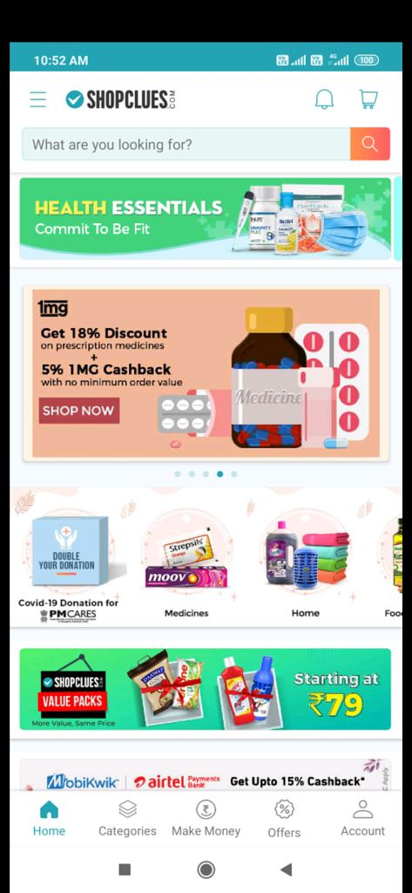
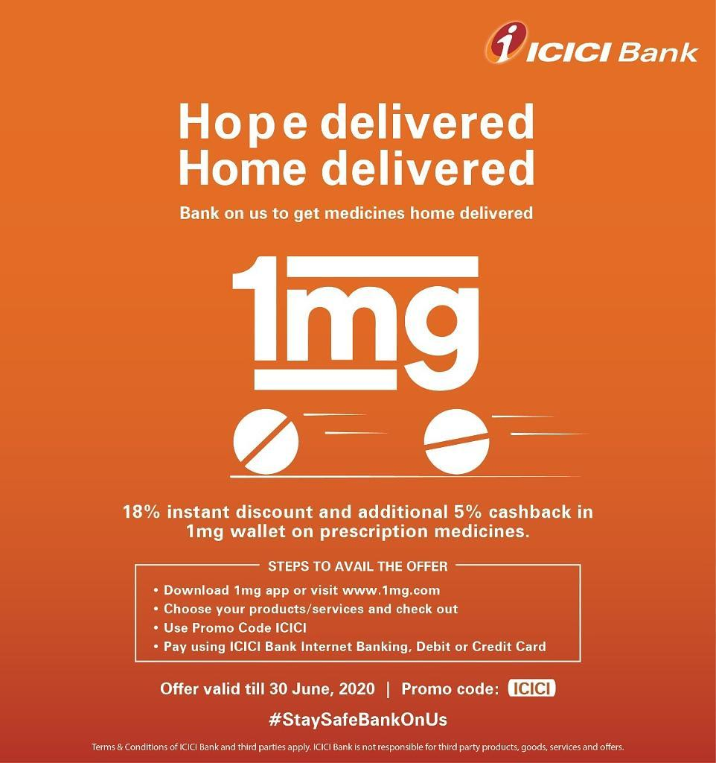
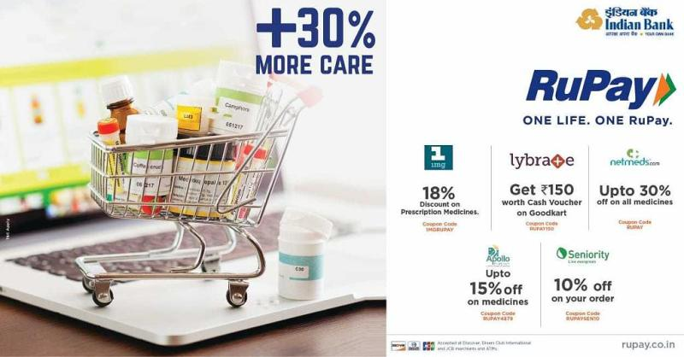
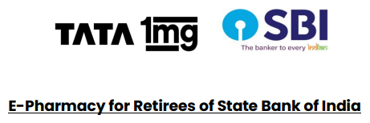
PROMOTION ON PARTNER PLATFORMS
SAMPLES
RUPAY CARD
ICICI BANK
SHOP CLUES

Slide 22
MULTICHANNEL MARKETING
PROJECT
GOAL:To grow the platform customer base by improving brand reach and consumer experience and communicating company and partner offers with audiences across multiple touch points during the special promotional campaign known as the “ Good Health Sale “.
ACTION: Created detailed multichannel marketing plans for reaching the customers through all viable web and app-based media channels, customized marketing messages to promote the special sale and partnership as per channel strategy and carried out cross-functional internal and external communications to ensure timely promotions across each of the media, including the media buying , negotiating, documentation and payments.
RESULT: The Good Health Sale that ran for 15 days was a huge success, bringing in 2.5x daily revenue during the campaign and led to our partner HDFC bank
Seeing greater spending on their cards, ensuring sustained partnership.

Slide 23
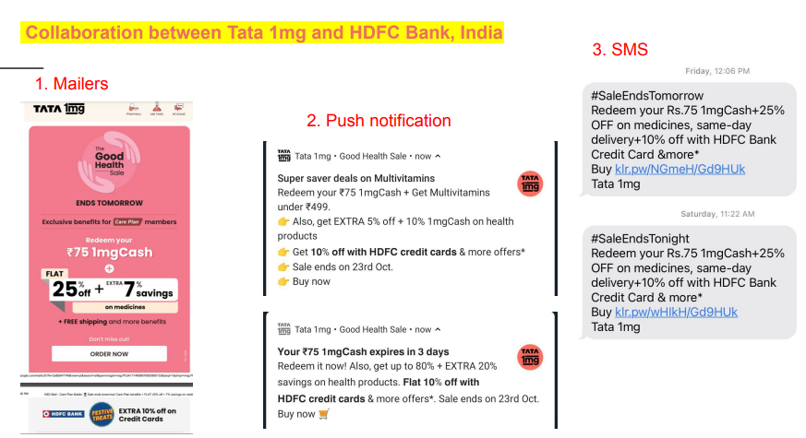
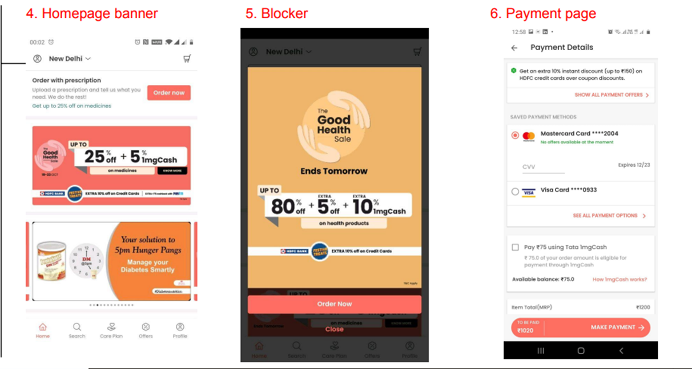
SAMPLES

Slide 24
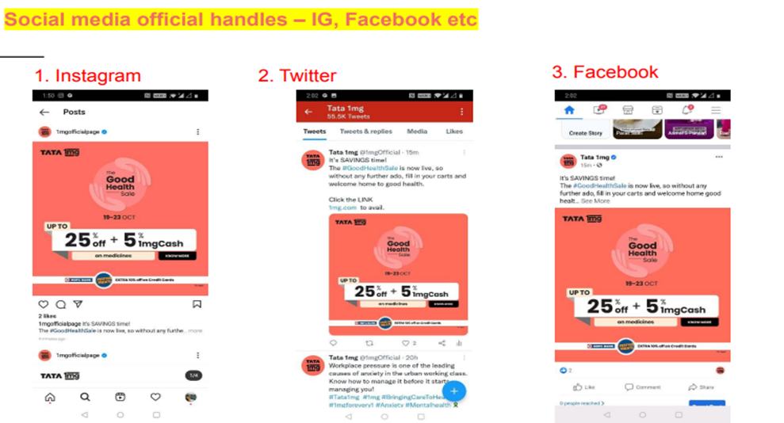
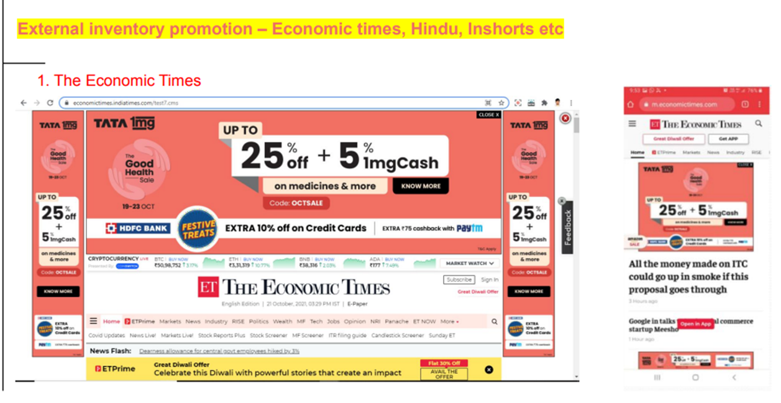
SAMPLES

Slide 25
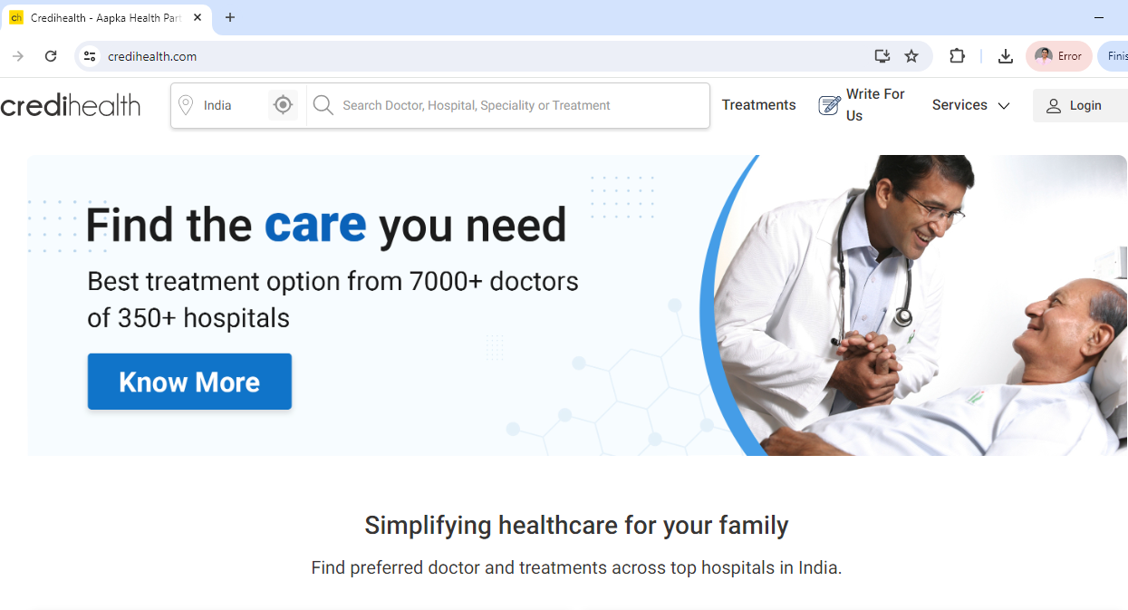

CREDIHEALTH (Medical consultation firm )
ORGANIZATION

Slide 26
Web Optimization, Digital Marketing
PROJECT
GOAL: To generate international leads and boost the firm’s new user acquisition by 40%, increasing the monthly active users for the online platform within 3 months by establishing a digital brand presence in Bangladesh, Nepal, the Netherlands, and Myanmar, and enhancing brand trust and credibility.
ACTION: Improved the website landing page as per customer insights, included verified medical content to establish thought leadership, engaged customers through community building such as “ladies and babies club” , set up testimonials carousal to enhance credibility and ran Google Ad campaigns with relevant patient-centric keywords and strategies to boost lead generation and new user acquisition.
RESULT: The number of monthly active users ( MAU ) increased by 50%, and Ad campaign delivered an exceptional ROI of 200% , leading to campaign continuation with greater budgets and the cost of acquisition ( CAC ) for these customers was down 15%

Slide 27
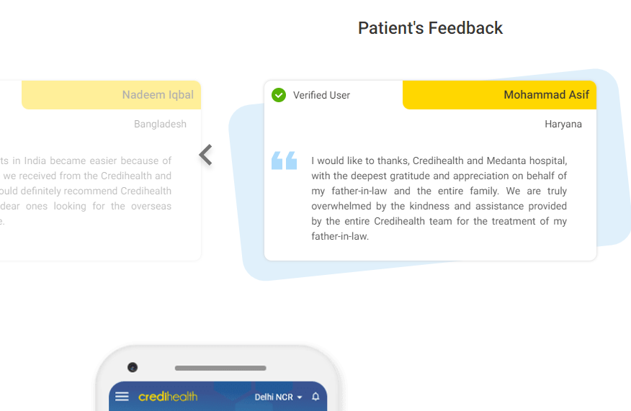
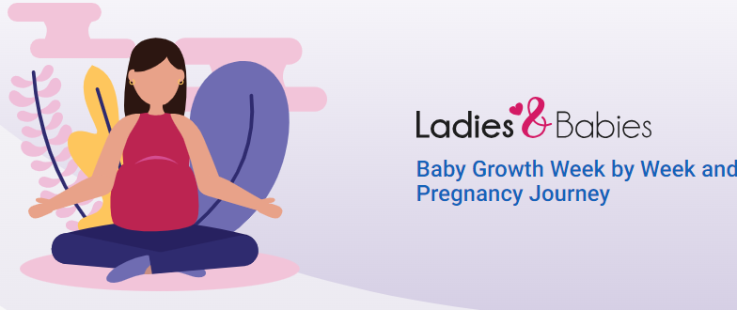
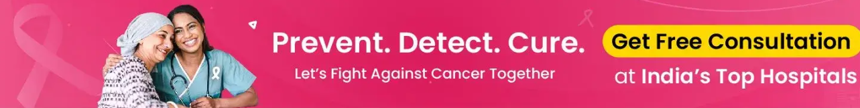
Community Engagement
SAMPLES
Brand trust building
Click to Action prompts

Slide 28
Customer Journey Mapping
PROJECT
GOAL: To increase conversion rate and thereby revenue through historical data analysis followed by process optimization to make the customer journey smoother and remove any friction points.
ACTION: Used MS Excel ( Pivot tables, Vlookup) to analyze customer data, evaluated turn-around-time ( TAT ), conversion rate, popular treatments, hospitals and classified them as per customer source and characteristics and revised customer journey utilizing Website ( CTAs, FAQs) and CRM improvements( system-driven emails), automation tools ( document readers, voice notes), prioritization matrix and personnel training to reduce customer waiting times and provide improved service.
RESULT: The conversion rate increased by 33% over the course of 6months, the revenue increased by 80% and most onboarded customers became loyal clients as a result of the easy process reporting a retention rate of 91%.

Slide 29
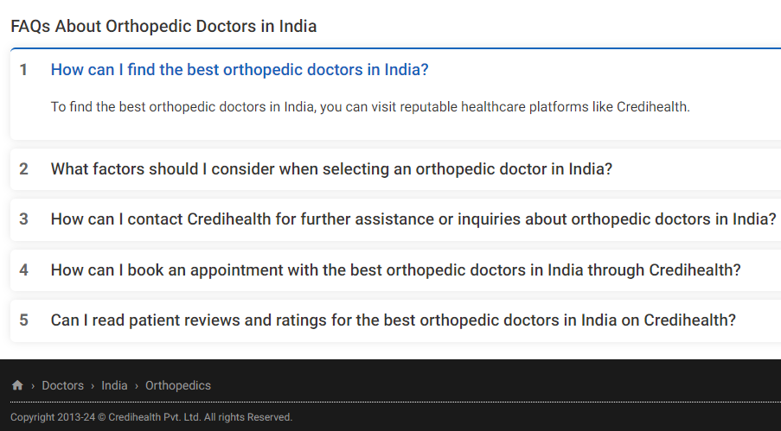
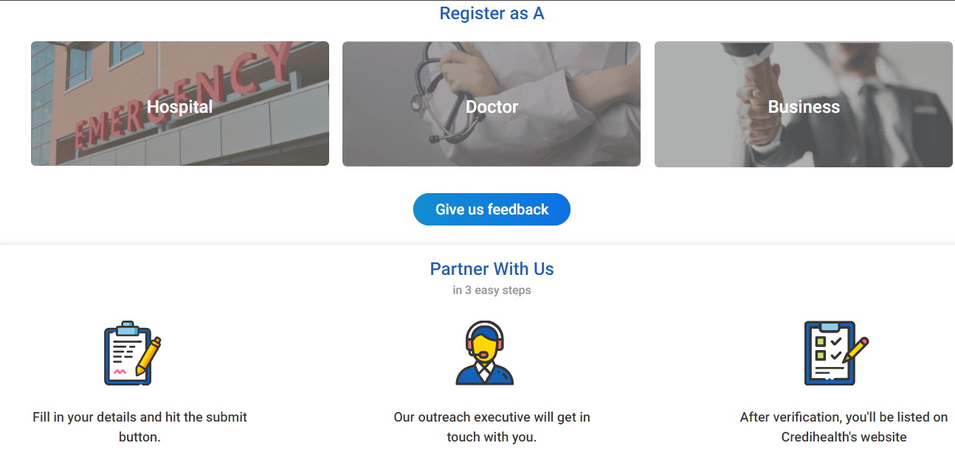
SAMPLES
Informative graphic to educate customers about the process and encourage communication
FAQs for every treatment, doctor and hospital category to help customers make informed decisions

Slide 30
“ Whether B2B or B2C, I believe passionately that good marketing essentials are the same. We are all emotional beings looking for relevance, context and connection.”
- Beth Comstock, CMO, General Electric

Slide 31

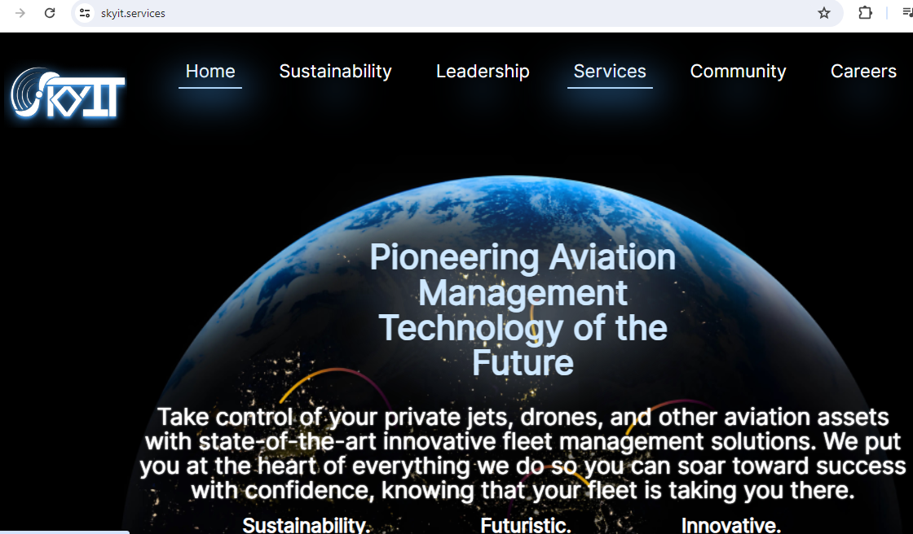
SkyIT SERVICES, GBCS Group
ORGANIZATION

Slide 32
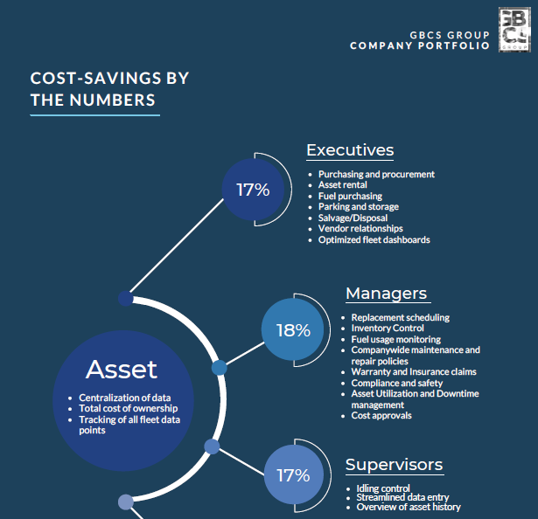
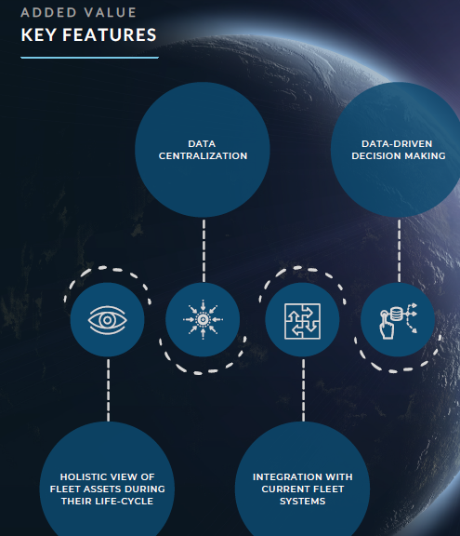
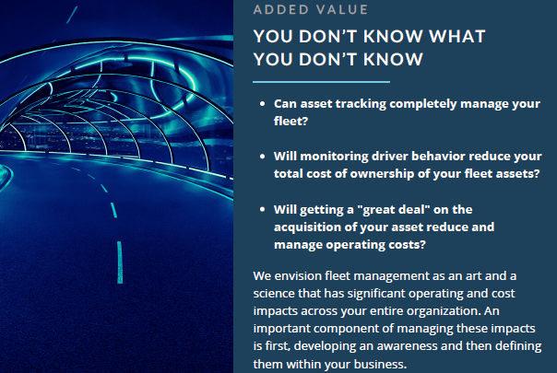
PROJECT
SAMPLES
B2B Marketing Campaign
GOAL: To onboard new clients and increase revenue by reaching out to decision makers personally, promoting the products and services and offering free demos
ACTION: Created marketing portfolio to best represent the SAAS platform’s value and formulated targeted emails to fleet managers, directors to generate leads and initiate the client association.
RESULT: The response rate to the emails was 60% as a result of accurate targeting and compelling content and the conversion rate post demo was 75%.

Slide 33

VOSYN AI, AI VENTURE LABS
ORGANIZATION
Project: Market Planning for Voice-based LLLM
Goal:
Action:
Result:

Slide 34

PROJECT
SAMPLES
GO-TO-MARKET STRATEGY
GOAL: To create a Go-To-Market Strategy for the voice-based LLM as per target audience profile and business objectives.
ACTION: Performed detailed market research and devised an effective Go-To-Market Strategy including Value Proposition, Branding, Pricing etc.
RESULT: The strategic plan was appreciated by industry experts and investors and helped contribute to the company’s capital funding round.

Slide 35




My Education
BRAND MANAGEMENT
MASTER OF BUSINESS ADMINISTRATION ( STEM )
Marketing Concentration
DIGITAL BRANDING
AI IN MARKETING

Slide 36
THANK YOU!
Abha Yadav
+1 4088335409
ayadav5@dons.usfca.edu

Slide 37

EDUCATION
QUALIFICATIONS, PROJECTS, SAMPLES

Slide 38
STEM MBA CLIENT PROJECTS
UNILEVER: QUALITATIVE MARKET RESEARCH
ENIGMA DATA : MARKETING RESEARCH AND CUSTOMER ONBOARDING PLAN

Slide 39
OHANA AI: GO-TO-MARKET STRATEGY, UX OPTIMIZATION
SOCIAL ENTERPRISE: DIGITAL FUNDRAISING STRATEGY

Slide 40
OTHER MBA PROJECTS
AIRBNB : Historical data analysis ( SQL, Tableau)
UBEREATS: Business Strategy Ideation and Management
BED, BATH AND BEYOND: Financial Analysis & Forecasting
HI-BOY e-SCOOTERS: Digital Marketing Strategy and Planning
FIGS: Company Analysis, and expansion-based growth strategy
TEAM BUILDING and LEADING: Lessons from NBA, NFL players
DIGITAL TRANSFORMATION for MS OFFICE products
SOCIAL MEDIA STRATEGY ( Tik- Tok ) : Getting 10k subscribers in 1 week
MARKETING MANAGEMENT SIMULATION : Brand Launch, Competition Analysis
INNOVATION PROJECT: Launching my own AI-powered mental health app
MAGIS PROJECT: Setting up a social enterprise ( Live Cancer Free Foundation)
PREDICTIVE ANALYTICS AND DATA MINING

Slide 41
SAMPLES

Slide 42

TABLE OF CONTENTS
01.
ABOUT ME
02.
PROFESSIONAL EXPERIENCE
03.
EDUCATION
Background, Personal Statement
Organizations, Projects, Samples
Qualifications, Projects, Samples

Slide 43

WORK EXPERIENCE
ORGANIZATIONS, PROJECTS, SAMPLES

Slide 44
CAMPAIGN RESULTS ( TATA 1MG)
60% increase in B2C Sales
150% increase in App and Web traffic
250% Growth in New User Acquisition
4x Rise in Monthly Revenue
120% Return on Investment

Slide 45


Slide 46
SKILLS
COMMUNICATION
CREATIVE THINKING
PROBLEM SOLVING
CONTENT MANAGEMENT
INTERPERSONAL SKILLS
NEGOTIATION
RELATIONSHIP BUILDING
PAID ADVERTISING
SEARCH ENGINE OPTIMIZATION
TARGETED EMAIL MARKETING
ONLINE NEWSPAPER ADVERTISING
AFFILIATE MARKETING
TELEVISION ADVERTISING
SOCIAL MEDIA MARKETING
STRATEGIC PARTNERSHIPS
INFLUENCER MARKETING
DIGITAL MARKETING
CROSS - PROMOTIONS

Slide 47


Slide 48


Slide 49
TATA 1MG Healthcare( Healthcare eCommerce platform )
Growth Marketing Executive
Marketing Strategy Ideation and Execution, Account Management, Affiliate Marketing, Lead Generation, Client Onboarding, Negotiation, MS Excel, Client Service, Marketing Content creation and Distribution, Email Marketing, Cross - functional Collaboration, SEO
Assistant Marketing Manager
Market Research and Analysis, Digital Marketing, Strategic Partnerships Management, UX Optimization, App Promotion, Google Analytics, Google AdWords, You Tube Content Creation, Customer Acquisition & Retention, Event Marketing, Tableau, SEM, CRO, PPC
Brand Marketing Manager
Mobile Marketing, Customer Segmentation, Go-to-Market Strategy, UX Optimization, A/B testing, Social Media Marketing ( Instagram, Tik-Tok, LinkedIn), Influencer Marketing, Media Buying, Digital and TV Advertising, Brand Management, Customer journey mapping, Adobe Creative Suite, Salesforce, Marketo, Analytical thinking, Leadership

Slide 50
CREDIHEALTH (Medical consultation firm )
Marketing Operations Executive
Customer Relationship Management, Customer Service, Corporate Partnerships, Medical Consultation, Lead Conversion, Account Management, Content Management, Marketing Strategy, Lead Nurturing
Digital Marketing Executive
Historical Data Analysis, MS Excel, Campaign Optimization, Digital Marketing, Lead Generation, Sales Pipeline Creation, Website Optimization, Social Media Marketing, Team Building, Customer Acquisition

Slide 51
SkyIT SERVICES, GBCS Group
ORGANIZATION
MBA Marketing Intern
Digital Marketing [ UX Optimization, Email Marketing (B2B), Social Media Marketing ], Monday.com, Demand Generation, Customer Relationship Management, Market Research, SEO, User Acquisition
Project: Targeted Email Marketing Campaign, Social Media Campaign
Goal:
Action:
Result:

Slide 52
VOSYN AI, AI VENTURE LABS
ORGANIZATION
MBA Marketing Intern
Market Research and Analysis, 4P’s of Marketing ( Product, Price, Place, Promotion ), Go-to-Market Strategy, Value Proposition, Target Customer Profile, Media Planning, Marketing Content Creation, Innovation
Project: Market Planning for Voice-based LLLM
Goal:
Action:
Result:

